Slide 1

Ansible
Powered by
Rahamthulla Shaik

Slide 2
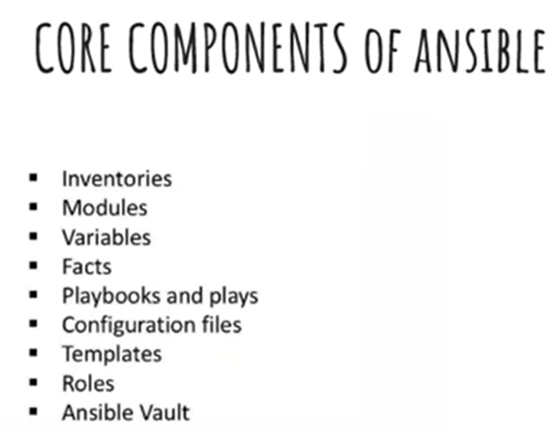

Slide 3
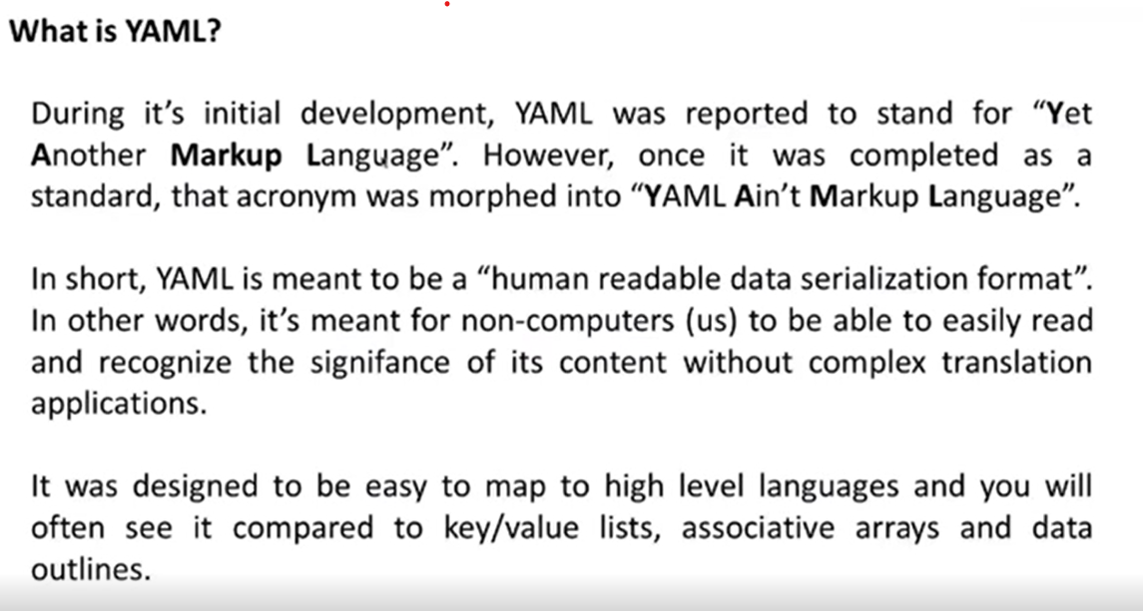

Slide 4
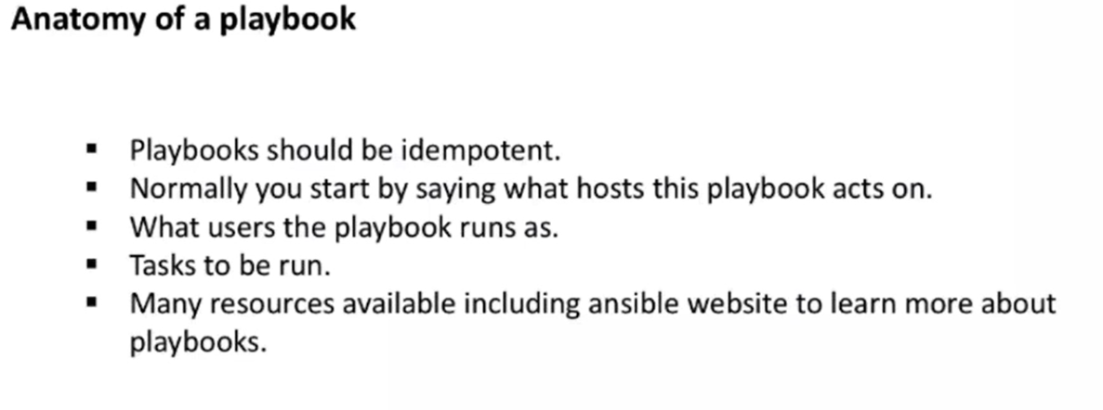
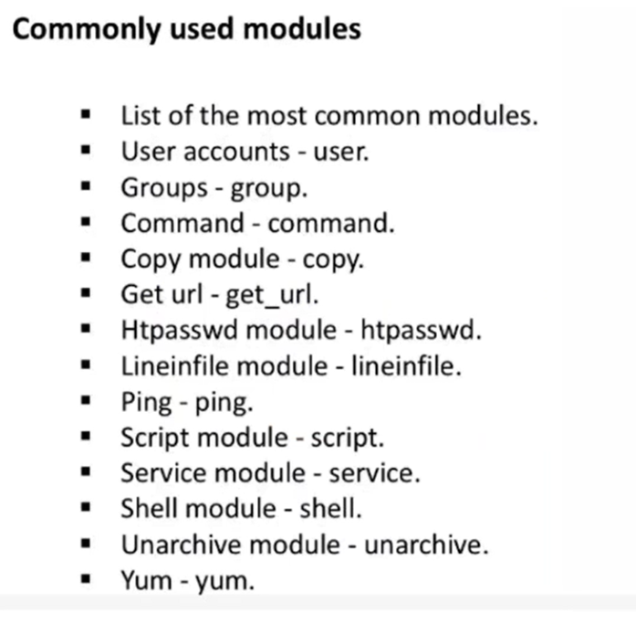

Slide 5
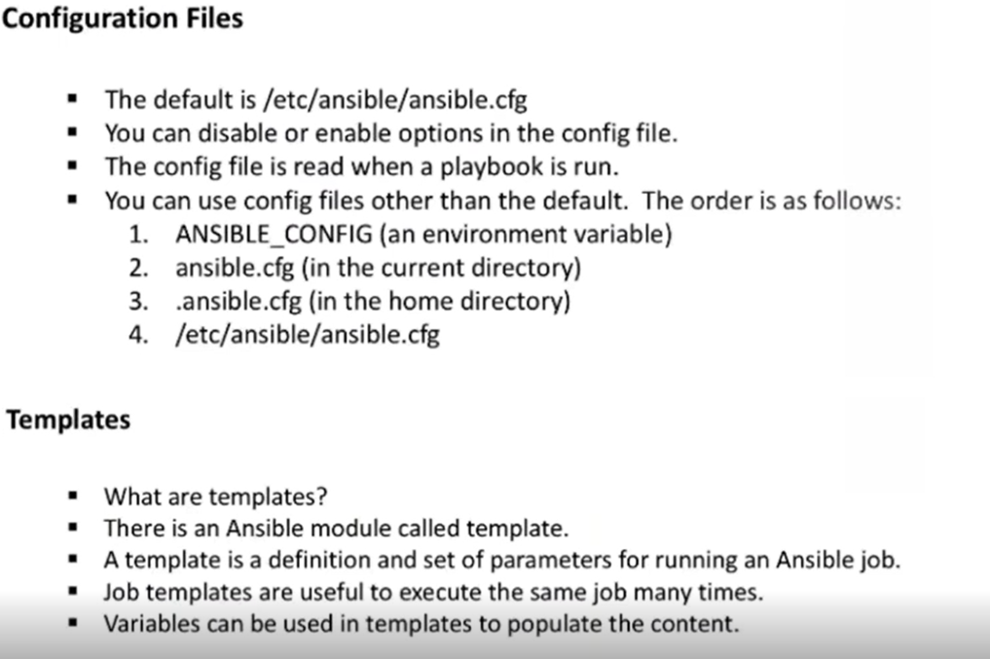

Slide 6
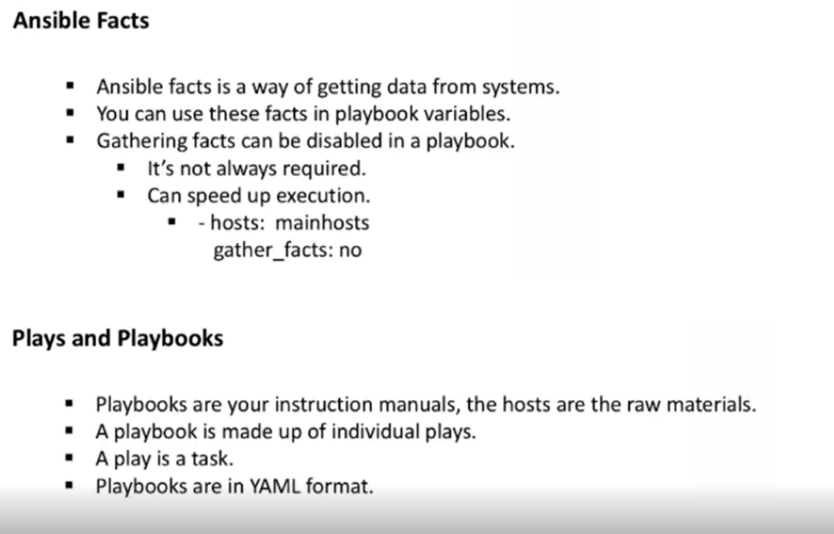

Slide 7
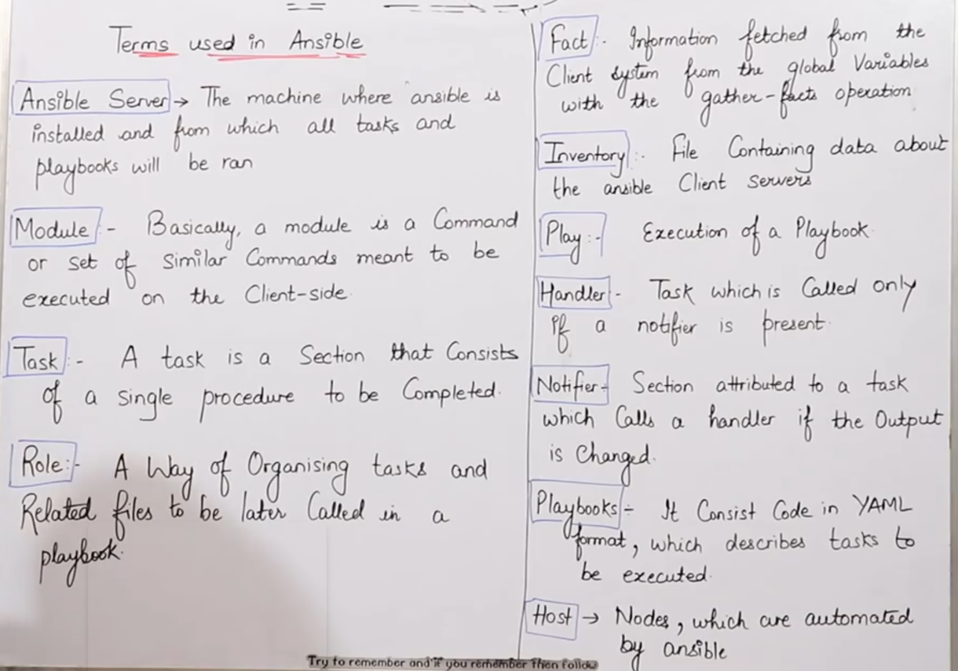

Slide 8
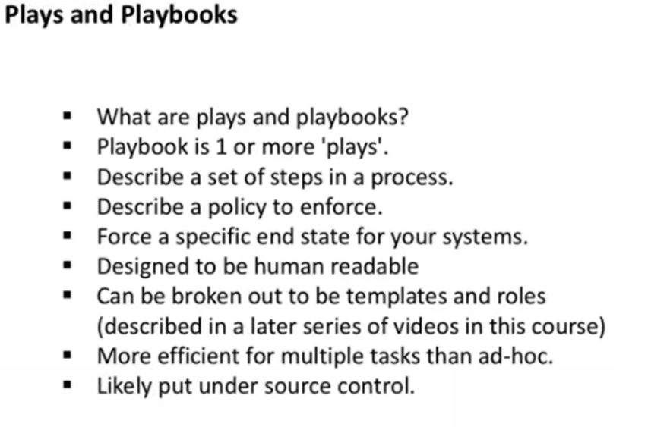

Slide 9
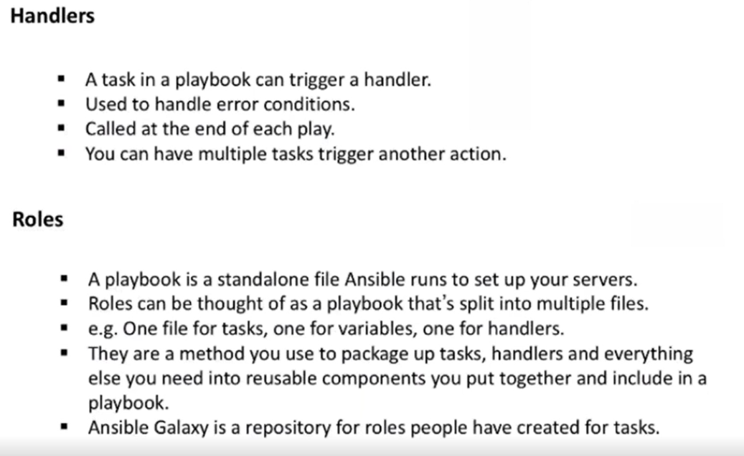

Slide 10
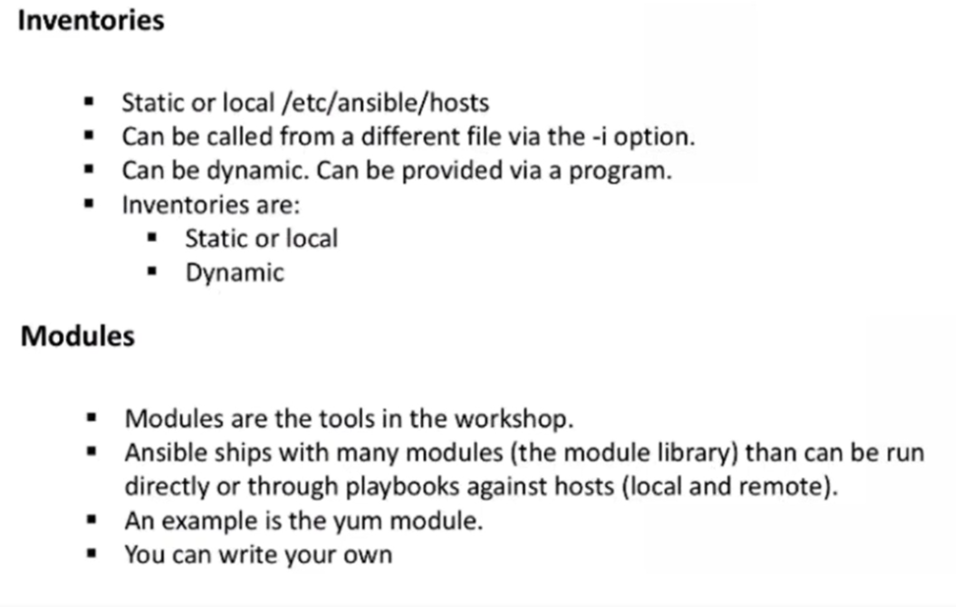

Slide 11
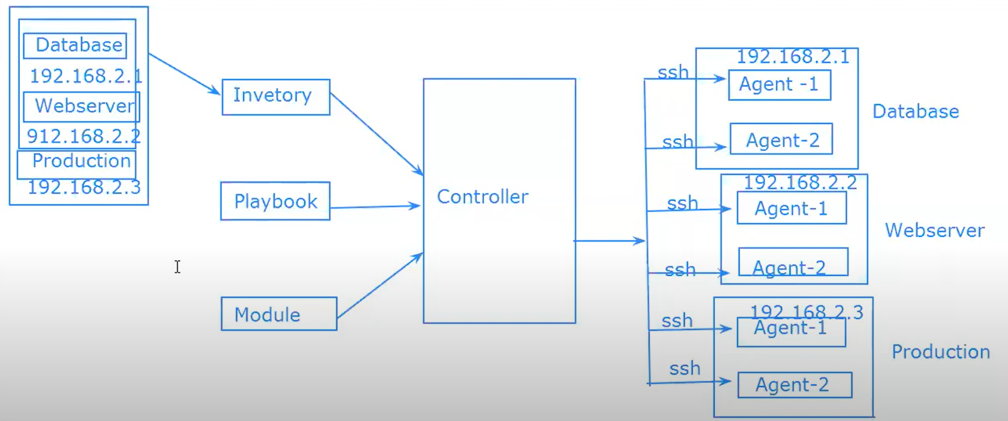
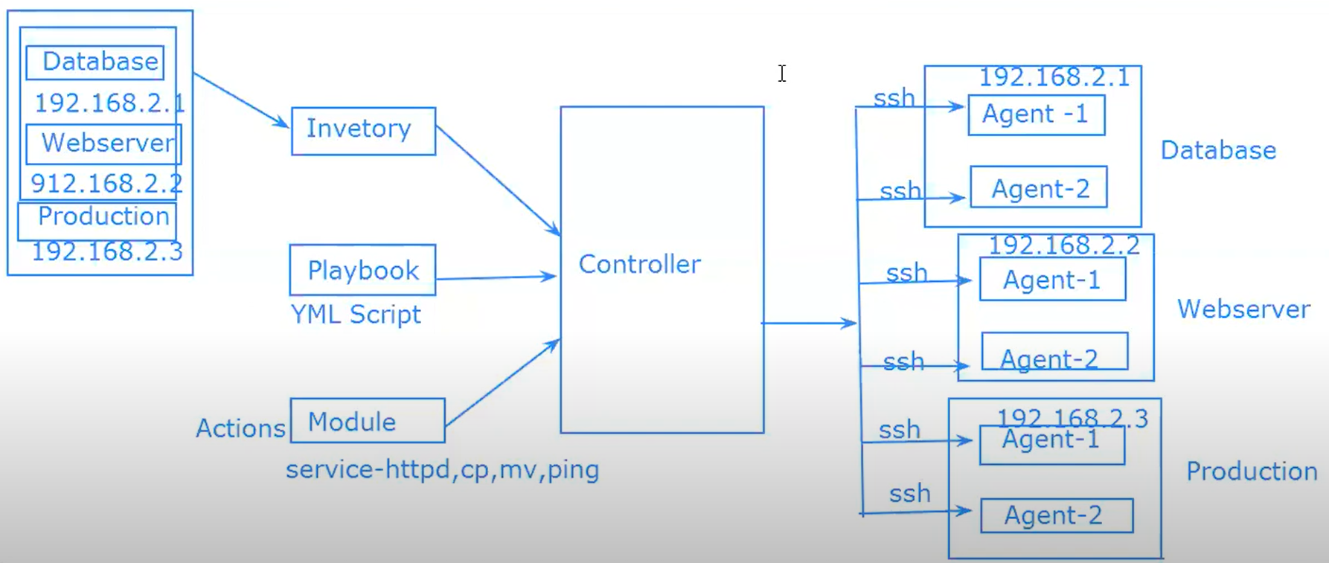
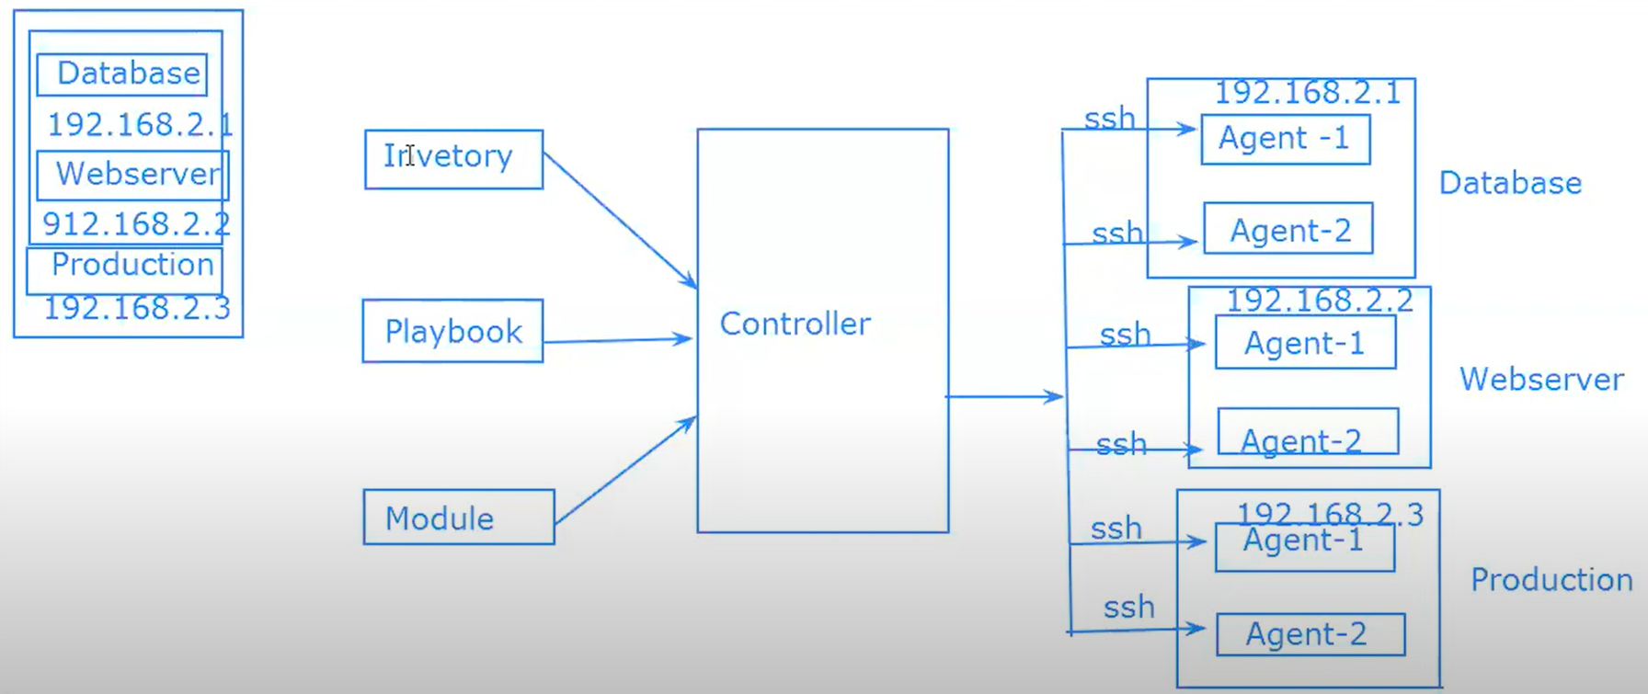
Ansible Architecture

Slide 12
Ansible Architecture contain mainly 3 modules
Inventory
All the server Ips will be configure here(IPs, tags, username & password)
file path /etc/ansible/host file is our inventory
[Database] [Webserver] [Database]
192.168.2.1 192.168.3.1 192.168.4.1
192.168.2.2 192.168.3.2 192.168.4.2
Playbooks
Playbook are written in the form of YAML script
All types is actions will do using playbook
It’s a combination of multiple Adhoc commands
3. Module/Configure
Using module we can Manage our agents
This all action will control the Controller, controller will interact with SSH so its called as agent less.

Slide 13
Potential Future Topics
Let me know if you want to know more.
Ansible Tower
Web-based dashboard for managing and executing tasks and playbooks
Specific strategies
Provisioning
Configuration management
Application deployment
Continuous delivery
Security automation
Orchestration
Roles
automatically load related vars_files, tasks, handlers, and other Ansible artifacts based on a known file structure
Questions?

Slide 14
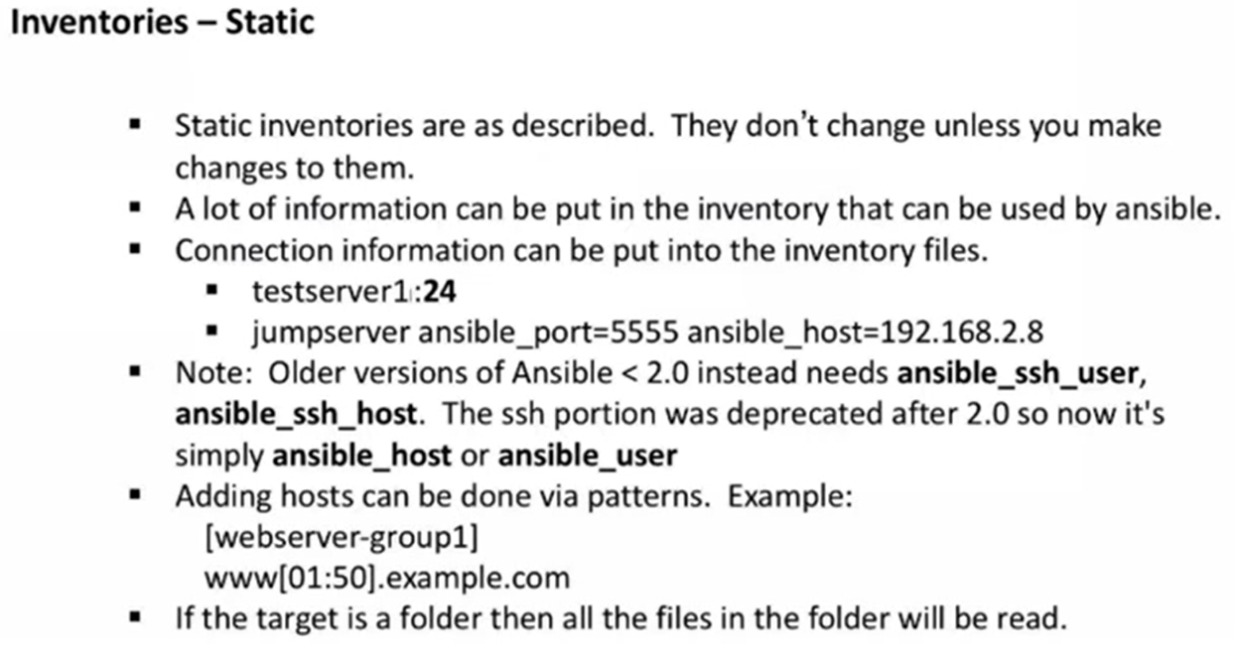

Slide 15
HANDLERS SECTION
A handler is the same as a task, but it will run when called by another task
Handlers are just like regular tasks in an ansible playbook, but are only run if the task contains a notify direction and indicates that it changed something
Dry Run: Check whether the playbook is formatted currently
ansible=playbook handlers.yml --check
--- # My PLAYBOOK FOR HANDLERS
- hosts: demo
user: ansible
become: yes
connection: ssh
tasks:
- name: install httpd server on centos
action: yum name=httpd state=installed
notify: restart httpd
handlers:
- name: restart httpd
action: service name=httpd state=restarted
$ ansible-playbook handlers.yml

Slide 16
Loops
Some to you want to repeat a task multiple times, in computer programing this is called loops common ansible loops include changing ownership on seral files or directories with the file module creating multiple users with the user module and repeating a polling step until certain result is reach.
Go to ansible server
$ vi loops.yml
--- # My Loops playbook
- hosts: demo
user: ansible
become: yes
connection: ssh
tasks:
- name: Add a list of users
user: name="{{item}}" state=present
with_items:
- Rahamthulla
- Zubair
- Sufyan_shaik
$ansible-playbook loops.yml
To verify Go to node1 $ cat /etc/passwd

Slide 17
Ad-hoc Commands
Ad-hoc commands are commands which can be run individually to perform quick functions
This Ad-hoc commands are not used for configuration management and deployment, because these commands are of one-time usage.
The ansible Ad-hoc commands uses the /usr/bin/ansible commands line tool to automate a single task
Go to ansible server
$ ansible demo -a "ls"
$ ansible demo[0:4] -a "touch sample.txt"
$ ansible all -a "touch file1"
$ ansible demo -a "sudo yum install httpd -y"
$ ansible demo -ba "yum install httpd -y"
$ ansible demo -ba "yum remove httpd -y"
Note: demo=group, -a=argument -b=become=sudo

Slide 18
Ansible Modules
Ansible ships a no of modules called module libraries that can be executed directly on remote host or through playbook
modules can start -m
$ansible demo -b -m yum -a "pkg=httpd state=present"
$ansible demo -b -m yum -a "pkg=httpd state=latest"
$ansible demo -b -m yum -a "pkg=httpd state=absent"
$ansible demo -b -m service -a "pkg=httpd state=started"
$ansible demo -b -m user -a "name=Raham"
$ ansible demo[-1] -b -m copy -a "src=raham-test dest=~/"
$ ansible demo[-1] -b -m copy -a "src=raham-test dest=/home/ansible“
$ ansible demo -m setup
$ ansible demo -m setup -a "filter=*ipv4*"

Slide 19
Advantages:
Ansible is free to use by everyone
Ansible is very consistent and lightweight and no constrains regarding the OS or underlaying hardware are present
It is very secure due to its agentless capabilities and open SSH security features
ansible does not need any special system administrator skills to install and use it
Push mechanism
Disadvantages:
Insufficient user interface through ansible tower is GUI but it is still development stages
Cannot achive full automation by ansible

Slide 20
YAML Characteristics:
Casting datatypes - normally, YAML will delete datatypes, but you may want to specify:
---
a:123 # An integer
b:"123" # a string, disambiguated by quotes
c:123.0 # a float
d:!!float 123 # also a float via explicit data type prefixed by (!!)
e:!!str 123 # a string, disambiguated by explicit type
f:!!str Yes # a string via explicit type
g:Yes # a Boolean True(yaml1.1), string "yes"(yaml1.2)

Slide 21
Conditions:
Whenever we have different scenarios, we put conditions according to the scenario
when statement
sometimes you want to skip a particular commands on a particular node
--- # CONDITIONAL PLAYBOOK
- hosts: demo
user: ansible
become: yse
connection: ssh
tasks:
- name: Install apache server for debian famly
command: apt-get -y install apache2
when: ansible_os_family == "Debian"
- name: install apache server for redhat
command: yum -y install httpd
when: ansible_os_family == "RedHat"

Slide 22
--- # MY PLAYBOOK
- hosts: demo
user: ansible
become: yes
connection: ssh
vars:
pkgname: httpd
tasks:
- name: Install HTTPD server on centos 7
action: yum name='{{pkgname}}' state=present
--- # MY PLAYBOOK-1
- hosts: all
user: ansible
become: yes
connection: ssh
tasks:
- name: find who is executing
command: whoami
- name: ping all
ping:
- name: Uninstall tree
yum:
name: tree
state: absent

Slide 23
SERVICE
--- # MY PLAYBOOK_Service
- hosts: all
user: ansible
become: yes
connection: ssh
tasks:
- name: Install apache server
yum:
name: httpd
state: present
- name: Ensure apache service is runninge
service:
name: httpd
state: started
enabled: yes
---# handlers
- hosts: demo
become: yes
tasks:
- apt:
name: tomcat7
state: present
update_cache: yes
notify: restart tomcat
- copy:
src: /home/ansible/myinv
dest: /home/ansible/myinvcopied
notify: restart tomcat
handlers:
- name: restart tomcat
service:
name: tomcat7
state: restarted

Slide 24
Tags
In a playbook we have multiple tasks, if you run playbook, it will execute all.
using tags, we can limit execution of tasks in playbook
vi my-tag.yaml
---
- hosts: all
remote_user: root
vars:
file_path: '{{filename}}'
tasks:
- name: Delete user
user:
name: "{{username}}"
state: absent
remove: yes
tags:
- delete_user
- name: Create user
user:
name: "{{username}}"
shell: /bin/bash
groups: "{{groupname}}"
password: "{{ password |password_hash('sha512') }}"
tags:
- create_user
- name: Add ssh key
authorized_key:
user: "{{username}}"
key: "{{lookup('file', 'file_path')}}"
exclusive: yes
tags:
- add_ssh_key
ansible-playbook my-tag.yaml
ansible-playbook my-tag.yaml --tags=create_user
ansible-playbook my-tag.yaml --skip-tags=delete_user,add_ssh_key

Slide 25
Roles:
We can use two techniques for reusing a set of tasks include and roles
Roles are good for organizing tasks and encapsulating data need to accomplish those tasks
Ansible Roles
We can organize playbooks into directory structure called roles
Adding more and more functionality to the playbooks will make it difficult to maintain in a single file
Ansible Roles
Default
Files
Handlers
Meta
Templates
Tasks
Vars

Slide 26
Roles
Ansible roles provides a standard way to reuse our playbooks
It creates a standard structure and separates tasks, files, templets, handlers etc.
Rolling update is one of the deployment strategies
Using rolling updates, we achieve zero downtime while rolling out new features.
For example, we are deploying was files onto 50 tomcat servers in production,
using roiling updates, we can roll out new features with zero downtime.
Default: It stores the data about role or application default variables
eg: if you want to run to port 8080 then variables needs to define in the path
Files: If contains files need to be transferred to the remote VM(static files)
Handlers: They are triggers or tasks we can segregate all the handlers required in playbook
Meta: This directory contain files that establish roles dependencies
eg: Author Name, support platform, dependencies if any
Tasks: If contains all the tasks that is normally in the playbook
eg: installing packages and copies files etc.
Vars: Variables for the role can be specified in this directory and used in your configuration files both vars and default stores variables

Slide 27
Ansible Vault
Ansible allows keeping sensitive data such as passwords or keys in encrypted files rather than a plaintext in your playbooks
Using vault, we can manage sensitive data
Passwords
Encrypted files
Vault encrypts sensitive information and keep in secure.
Command line tool ansible-vault is used to edit files
Command line flag is used --ask-vault-pass or --vault-password-file
Create a new encrypted playbook
ansible-vault create vault.yaml
Edit the encrypted playbook
ansible-vault edit vault.yaml
To change the password
ansible-vault rekey vault.yml
To encrypt an existing playbook
ansible-vault encrypt target.yml
To Decrypt the playbook
ansible-vault decrypt target.yml

Slide 28
What is dynamic inventory in ansible?
--- # IP won't be Constance, it will be changing
- hosts: Webservers
name: apache2
become: True
tasks:
- name: Install apache2 server
yum:
name: httpd
state: latest
- name: restart httpd
service:
name: httpd
state: restart
enabled: yes
--- #Create a directory for nginx install and restart
- hosts: all
user: ansible
become: True
tasks:
- name: Create a directory for nginx
file:
path: /home/workarea/nginx
state: directory
- name: Install nginx
yum:
name: nginx
state: latest
- name: Start nginx
service:
name: nginx
state: started

Slide 29
What is Ansible?
Simple and easy IT automation
Push model via OpenSSH, agentless
Provisioning
PXE booting and kickstarting bare-metal servers or VMs, or creating virtual or cloud instances from templates
Configuration management
Idempotent server state definitions
Application deployment
One-command standard deployments to update applications across many machines
Continuous delivery
Require sequential success of multiple processes
Security automation
Automate and standardize threat-scanning and firewall updates
Orchestration
Define how multiple configurations interact and ensure the disparate pieces can be managed as a whole
https://docs.ansible.com/ansible/latest/index.html
Notes:
Ansible is an IT automation tool. It can configure systems, deploy software, and orchestrate more advanced IT tasks such as continuous deployments or zero downtime rolling updates.
Ansible’s main goals are simplicity and ease-of-use. It also has a strong focus on security and reliability, featuring a minimum of moving parts, usage of OpenSSH for transport (with other transports and pull modes as alternatives), and a language that is designed around auditability by humans–even those not familiar with the program.

Slide 30
How does Ansible work?
Agentless
Tasks are executed from your machine
Automated
Reliable and less error prone
Playbooks
Configuration/Installation/Deployment in a single YAML file, doubles as notes
Inventories
Tasks can be executed on groups of machines
Module
Atomic task e.g. Copy file
Task
Uses a module with arguments
Play
A series of tasks with designated hosts and user
Playbook
A series of plays
https://www.ansible.com/overview/how-ansible-works

Slide 31
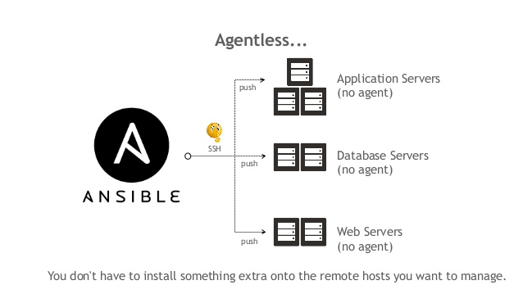
How does Ansible work? – Agentless
on
your machine
https://www.slideshare.net/DonghuKIM2/ansible-with-oci-221441463
https://www.ansible.com/overview/how-ansible-works

Slide 32
How does Ansible work? – Modules
Module examples
copy – copy files from control node to target
user – manage users and passwords
package - install, update, remove tools using target package manager
service – manage target system services using target init system
firewalld – manage firewall configuration
file – set permissions and ownership
lineinfile – manage single lines on existing files
command – allows for arbitrary commands, best practice is to avoid this
> ansible outland.fnal.gov -m ping
ansible – command line tool
outland.fnal.gov – remote hostname
-m – module flag
ping – built-in Ansible module that does exactly what it says
https://docs.ansible.com/ansible/latest/user_guide/modules_intro.html

Slide 33
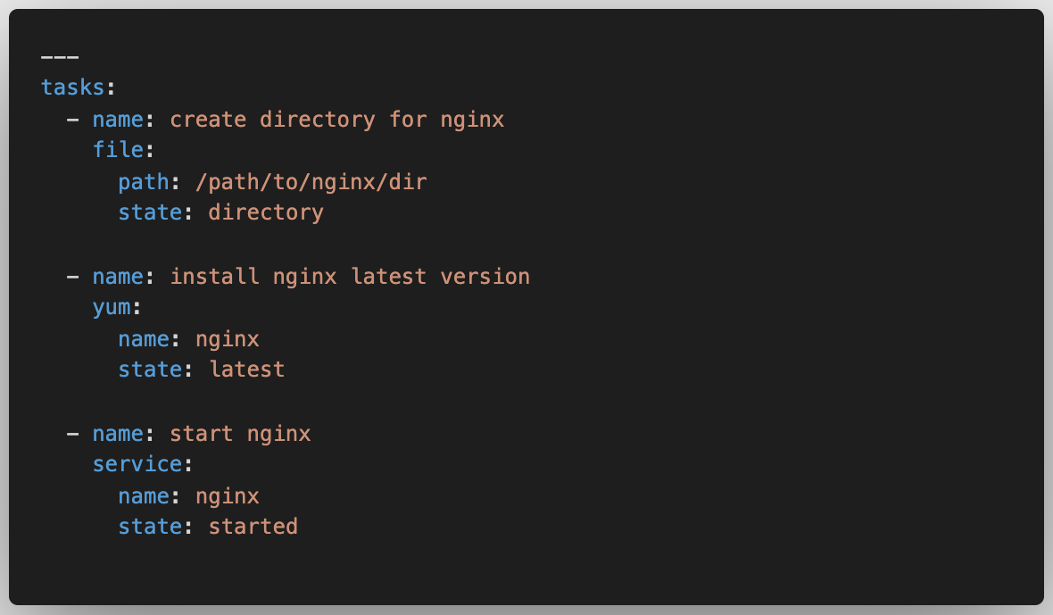
How does Ansible work? – Tasks
Tasks are modules with arguments.
Ansible allows users to create predefined series of tasks in YAML files.
https://docs.ansible.com/ansible/latest/user_guide/index.html#writing-tasks-plays-and-playbooks

Slide 34
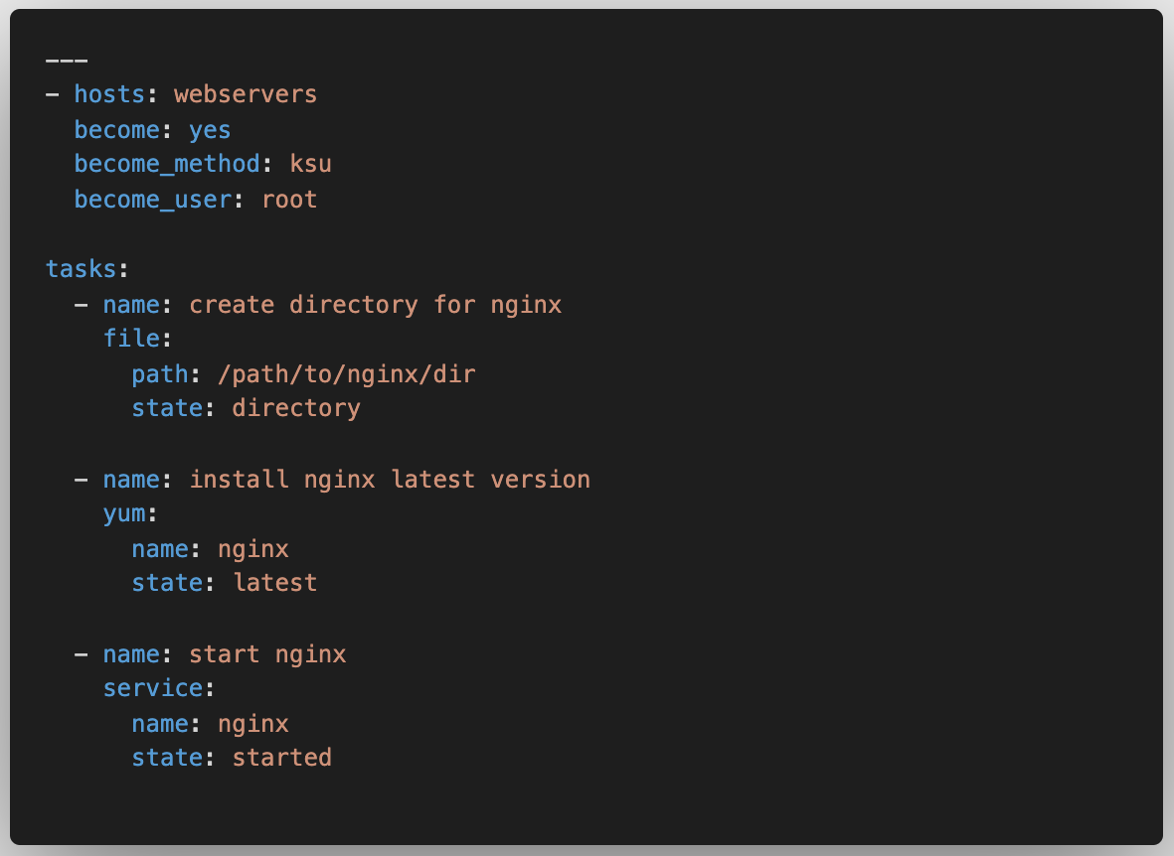
How does Ansible work? – Plays
Plays are a series of tasks with a designated hosts and user.
Ansible allows users to create predefined plays in YAML files.
https://docs.ansible.com/ansible/latest/user_guide/index.html#writing-tasks-plays-and-playbooks

Slide 35
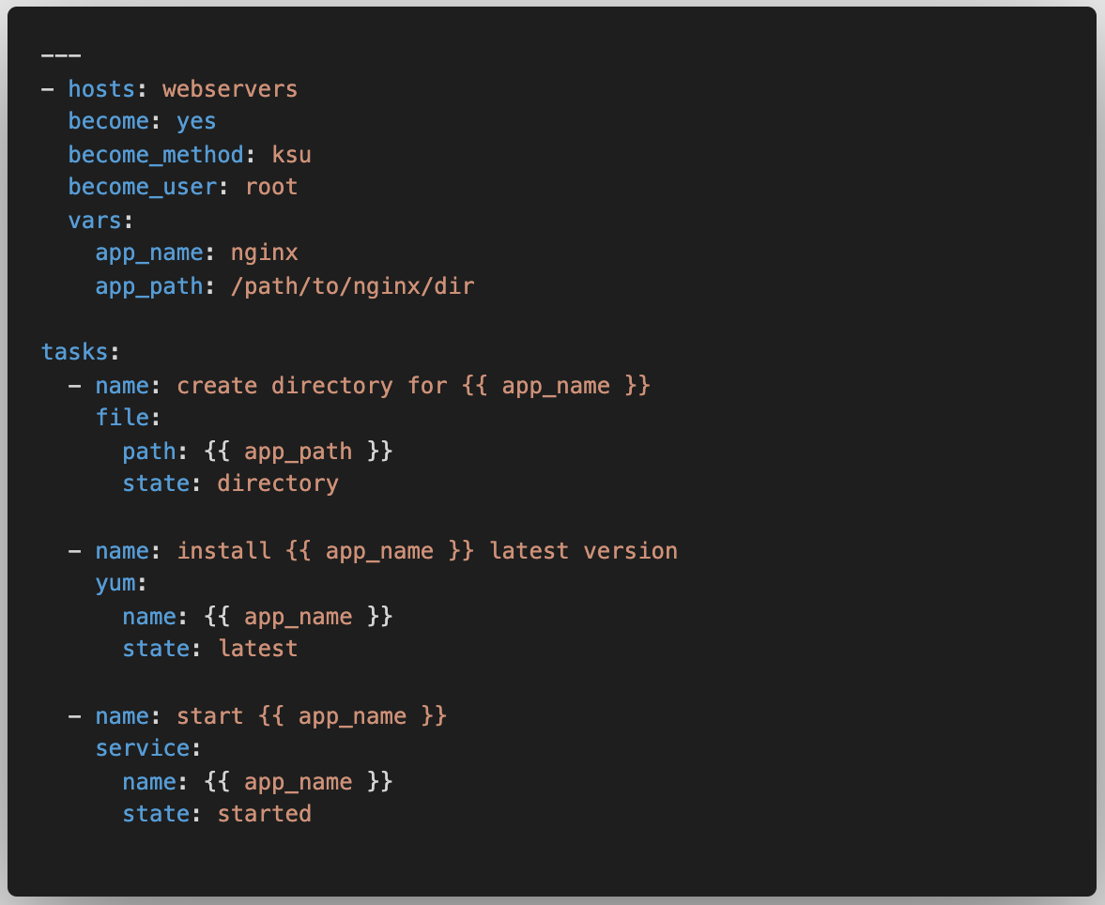
How does Ansible work? – Variables
Variables can help prevent typos and make updates simple.
It’s clear that if we can substitute the variables this play is a generic solution for installing and starting a service.
https://docs.ansible.com/ansible/latest/user_guide/playbooks_variables.html

Slide 36
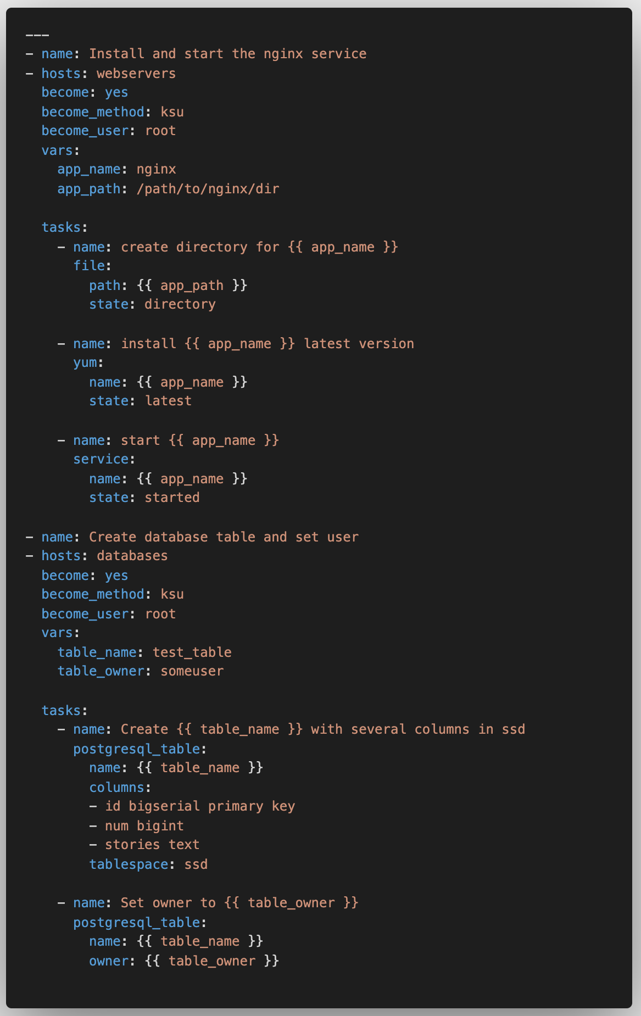


How does Ansible work? – Playbook
Playbooks define how, in which order, on which machines, and what modules should be executed.
Now we are orchestrating module execution!
What is this magic!?
”webservers” and “databases” are are inventories of remote hosts.
https://docs.ansible.com/ansible/latest/user_guide/playbooks_intro.html

Slide 37
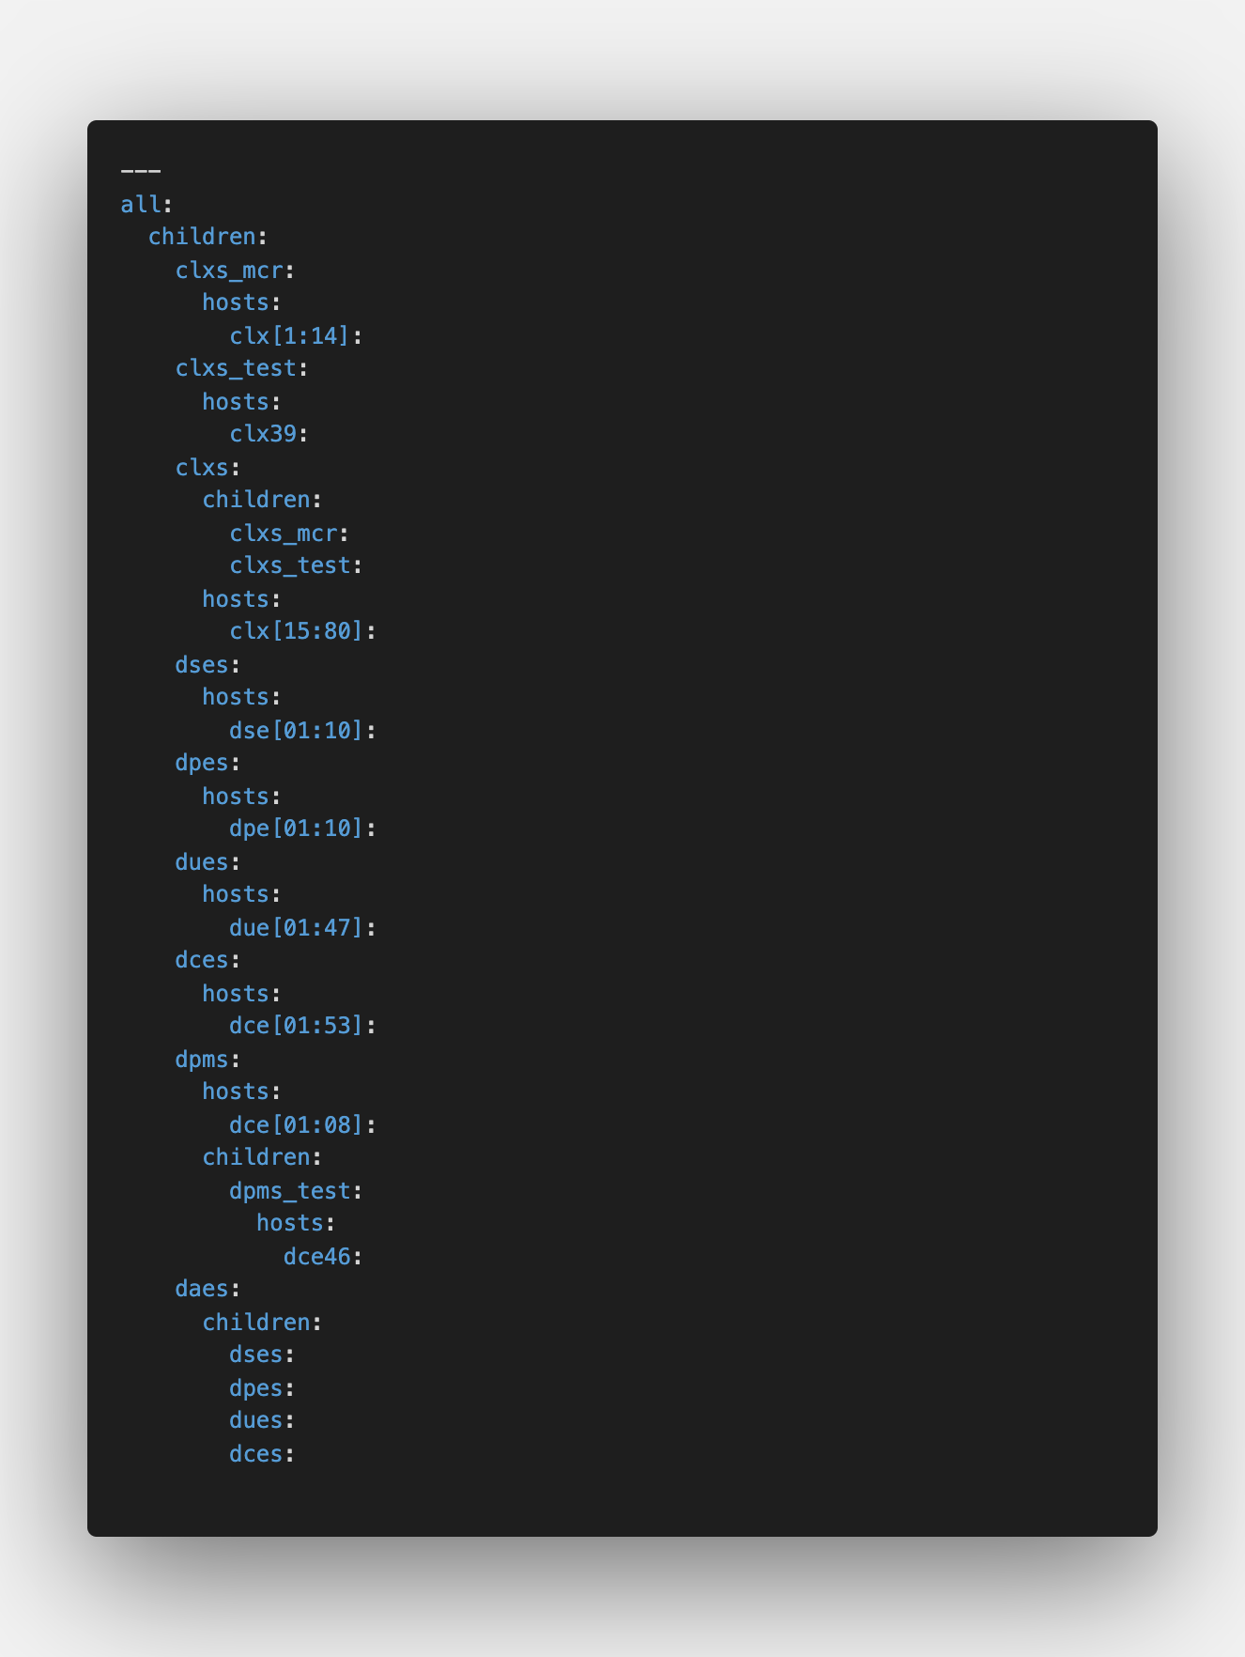
How does Ansible work? – Inventory
Groups allow for aliasing lists of targets
Hosts can be in multiple groups
Hosts with a common naming scheme can be added using the range syntax
This syntax also allows for a stride e.g. clx[01:80:2] odd CLXs
Ansible command line allows for pattern matching and sub-selection from inventory
Multiple hosts/groups – dses:dpes
Exclude – daes:!dpms
Intersection – dces:&dpms_test
> ansible-playbook test-playbook.yaml --limit ‘all:!clxs_test:!dpms_test’
https://docs.ansible.com/ansible/latest/network/getting_started/first_inventory.html

Slide 38
Beau’s imagined use cases
Deploy applications and configurations to production and backup nodes
Doing this with the Interlocks servers
Upgrade OS
I’m going to attempt to use Ansible to aid in upgrading Interlocks server from SLF6 to SLF7
Gather statistics
Replace Bash and Python scripts in determining the state of many machines
Manage permissions
New users could be added to disparate systems using a common Controls inventory
Last leg of continuous deployment
Simply automate fetching, testing, and uploading code
Quick security updates
New firewall settings or application updates can be deployed to all systems with one command
Rolling updates
For systems with a load balancer or auto discovery, updates can be rolled out with interrupting service
Coordinated deployments
Interdependent services can be coordinated to deploy simultaneously

Slide 39
How to check syntax of playbook without executing:
ansible-playbook apache.yml --syntax-check
What is dry run mode in ansible? ansible-playbook apache.yml --check
Default ansible location:
$ Sudo vi /ets/ansible/ansible.cfg
retry_file_enabled = True
host_key_checking = False
vi /ets/ansible/hosts
[webservers]
add ips
[loadbalancer]
add ips
---#dryrun.yml
- hosts:all
become:True
tasks:"Git installation"
- name:Install git
yum
name:git
state:present
$ ansible-playbook dryrun.yml

Slide 40
Ansible Tower:
Ansible Tower(RedHat Ansible Tower) is web-based GUI tool, we can manage our infrastructure centrally and control most aspects of infrastructure configuration.
It support roal based projects
It is an enterprise edition, not free.
Ansible Tower Features
Graphical user interface (GUI) dashboard.
Role-based access control.
Job scheduling.
Multi-playbook workflows.
External logging integrations.
Real-time job status updates.
Clean dashboard
To set the notifications
Audit job and tower resource
Self service UI
REST API to take it father
Store the credential safely for different tools
manage inventory dynamically
Linux OS 64-bit min 20 GB H Disk min 4 GB RAM
if using AWS m4.large
1.Views
Dashboard
jobs
schedules
my view
2.Resources
Templates
credential
projects
inventories
inventory scripts
3.Access
Organization
users
trams
4.ADMINISTRATION
credential type
notifications

Slide 41
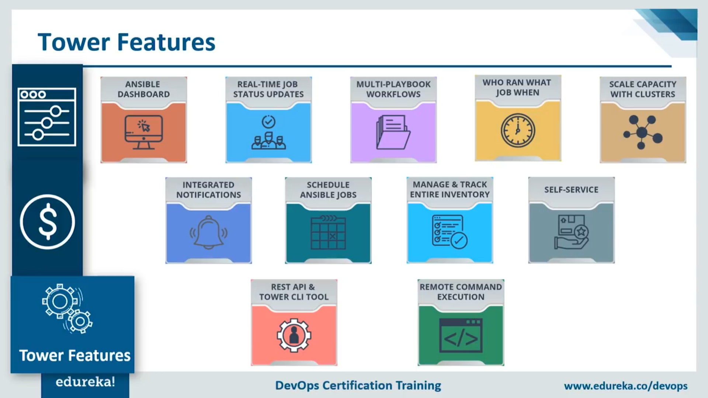

Slide 42
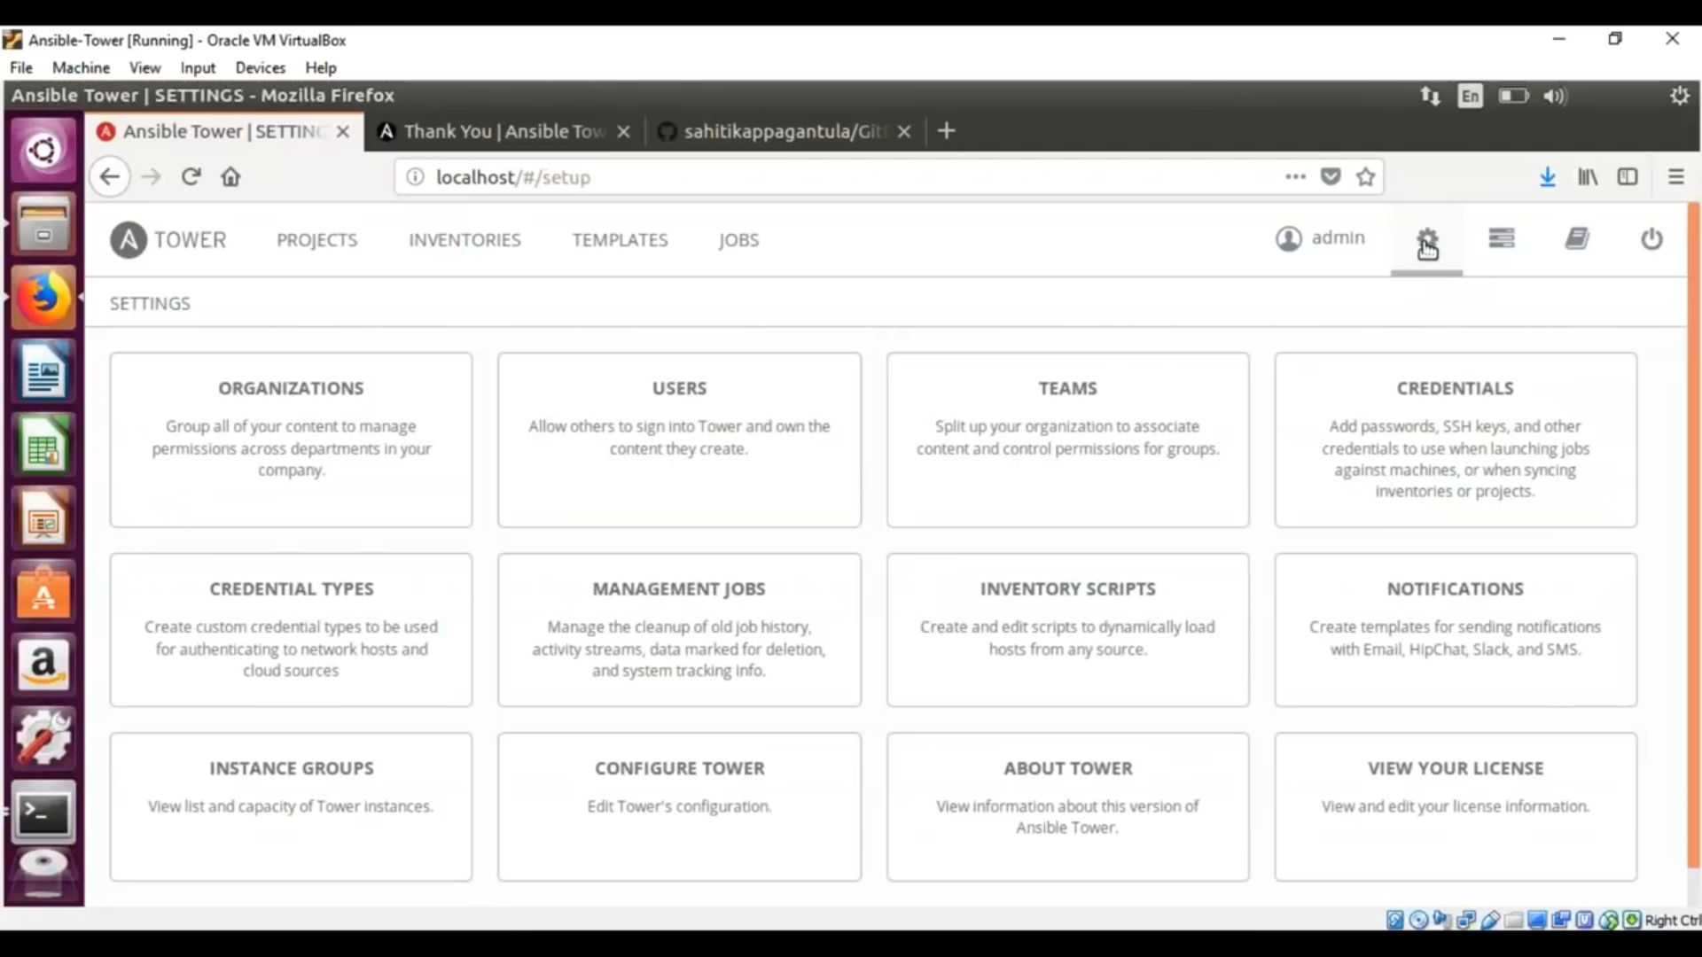

Slide 43
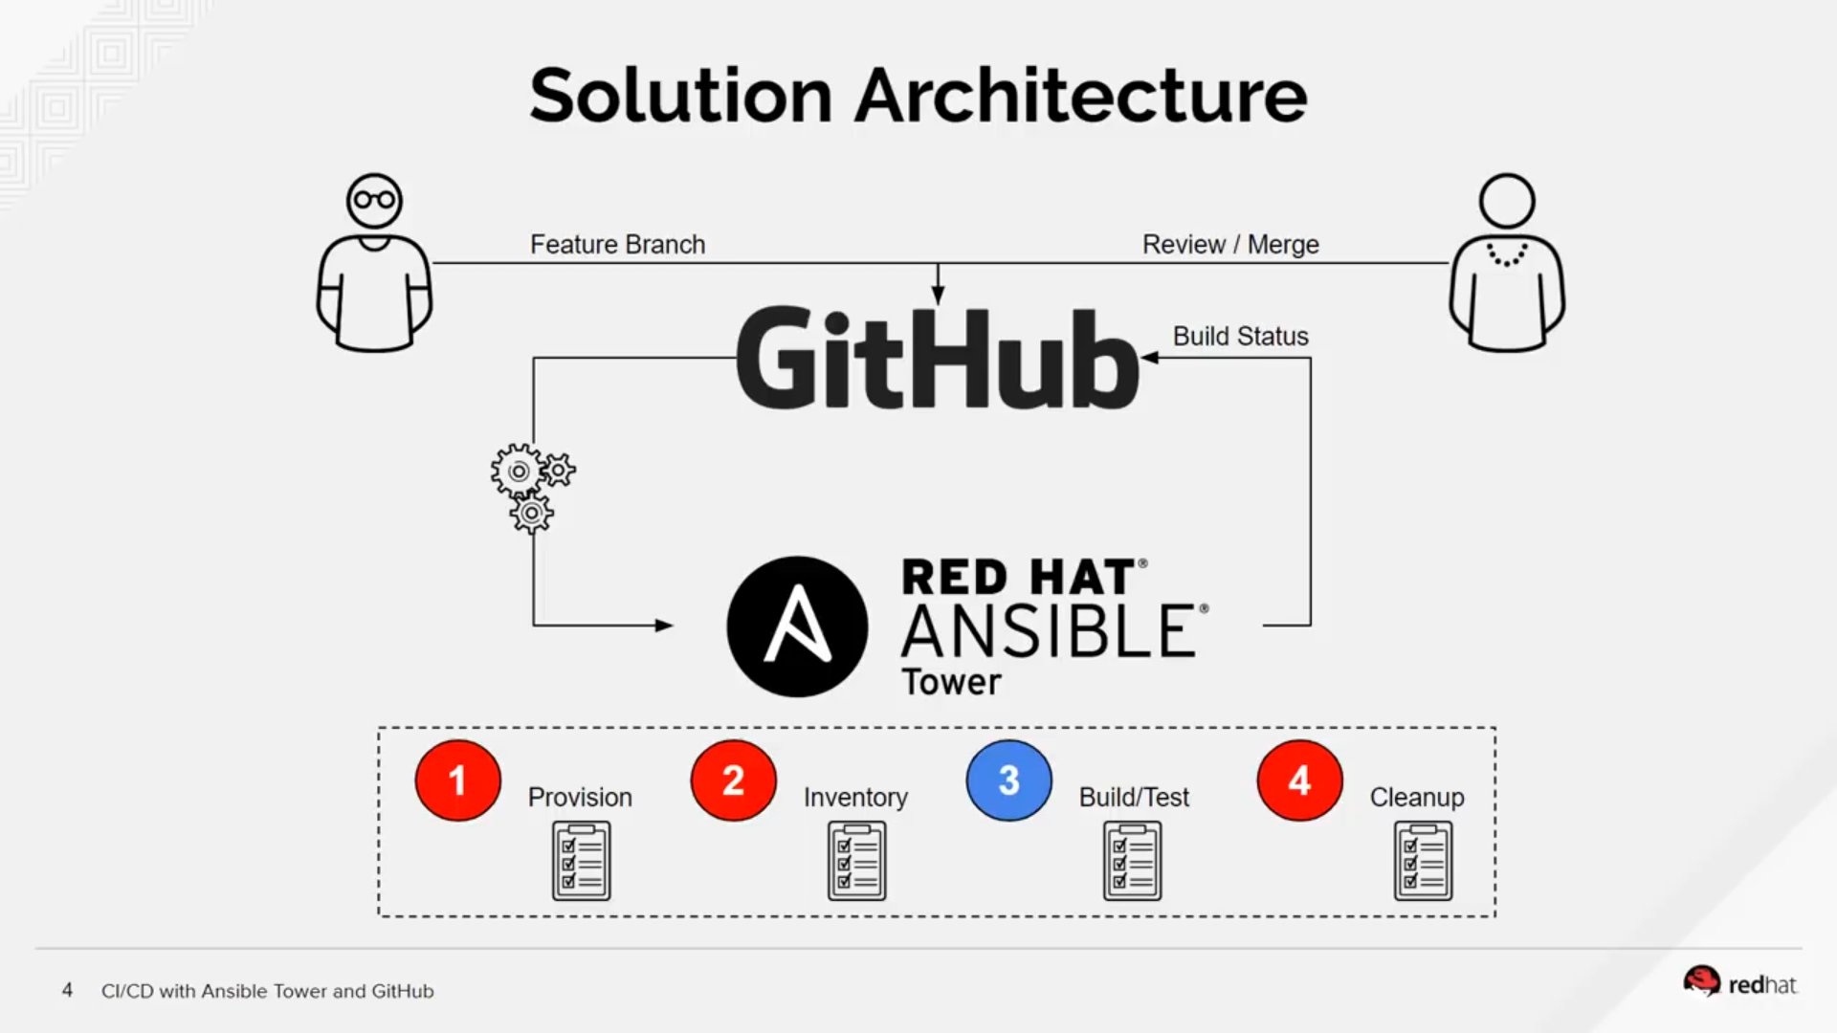

Slide 44
